Slide 1
Efficient Vertex-Label
Distance Oracles For
Planar Graphs
Shay Mozes and Eyal Skop
IDC Herzliya
WAOA 2015

Slide 2
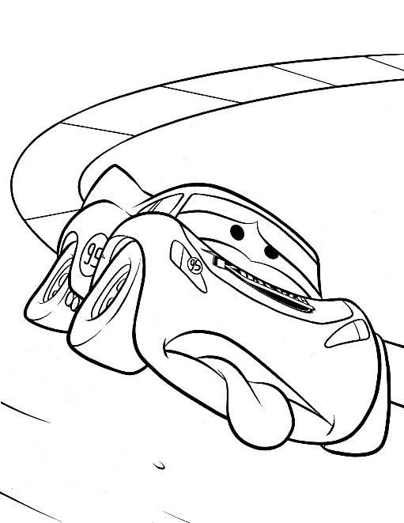


Motivation
Imagine you are driving your car and see
you are nearly out of gas.
What should you do?
Obviously, you should find the closest gas station.
Notes:
Hello everybody,
I would like to start of with a basic scenario:
Most of you probably encountered a situation where you are in grave need to find the closest gas station.
Well, this talk is meant to address this kind of problems.
Many of you know google maps and some of you might be familiar with waze application, which is a GPS navigation app.
Those two do not address this issue, but a simpler one, where you need to get to a specific gas station.

Slide 3
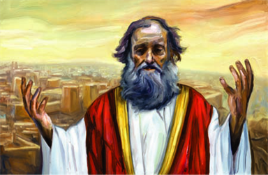
Distance Oracle
Given two locations,
answers the distance between the two
Notes:
These two (google maps and waze) are actually distances oracles. Meaning, they answers distance queries between two locations.

Slide 4
Vertices and Labels
Standard distance oracles
B
3
1
2
D
A
5
C
Notes:
Standard distance oracles retrieve the distance between two locations.
In this example, for the distance from A to C we should retrieve the distance 2.
The distance to the closest gas station cannot be addressed directly in this kind of queries.

Slide 5
Vertices and Labels
Vertex-Label distance oracles
B
3
1
2
D
A
5
C
Notes:
However, a Vertex-Label distance oracles retrieve the distance from a specific location to a location with a specific “label”, also sometimes referred as “color”.
For example, the distance from A to a green-labeled location is 1.
You can imagine the green-label specifies gas station, as for the example several minutes ago.

Slide 6
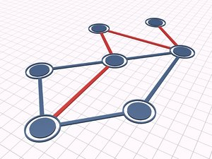
Important measures
Preprocess a graph Construction time
Keep minimal data Space requirement
Answer distance queries Query time
Notes:
An oracle is measured by 3 main measurements.
We first allow the oracle to compute and keep data. The runtime of this phase is called the construction time.
It then may answer queries using the data kept in the initial phase.

Slide 7


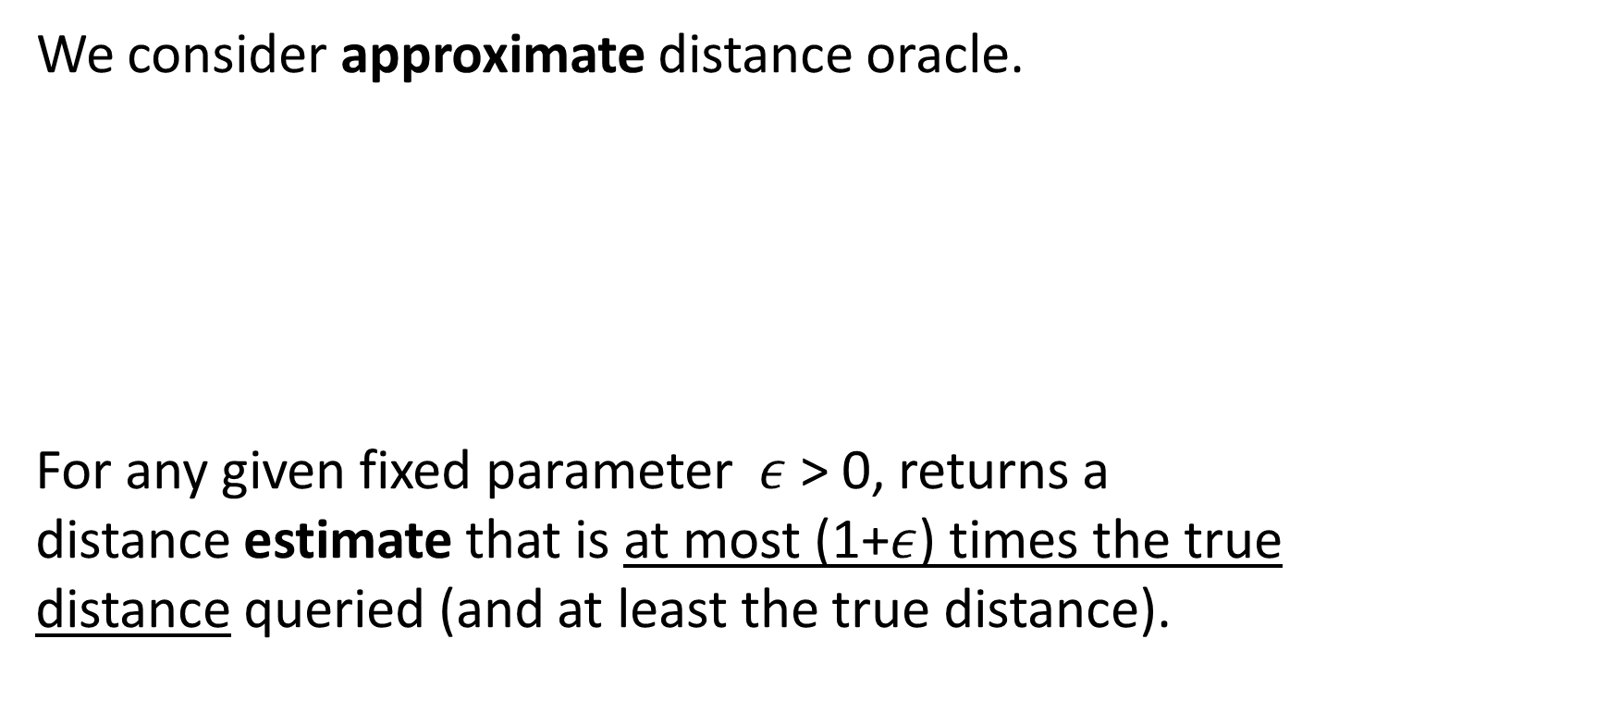
(1+$ε$)-stretch
We consider approximate distance oracle.
For any given fixed parameter $ε$> 0, returns a distance estimate that is at most (1+$ε$) times the true distance queried (and at least the true distance).
Notes:
In this talk we consider approximate distance oracles.
Meaning, the distance retrieved by the oracle is an estimation of the true distance.
An oracle which retrieves distance answers with estimation factor (1+eps) we call a (1+eps)-stretch oracle.
None exact distance oracles which have both low space and low query time were found.

Slide 8
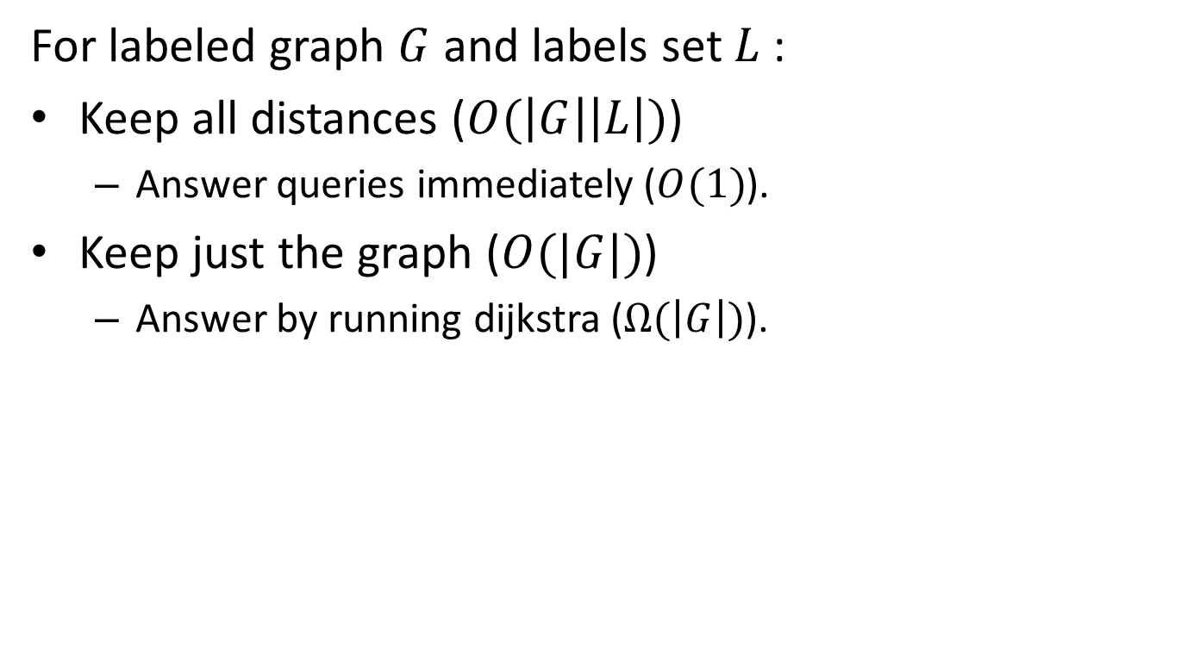
Naïve Solutions
For labeled graph $G$ and labels set $L$ :
Keep all distances ($O(\left|G\right|\left|L\right|)$)
  Answer queries immediately ($O(1)$).
Keep just the graph ($O(|G|)$)
  Answer by running dijkstra ($Ω(\left|G\right|)$).
Notes:
For a graph G where each vertex is labeled by a label in set L, there are two immediate easy solutions.
The first is to compute all answers to all queries which are about to be queried, and answer them on the spot when queried.
Note that the number of labels might be in the order of the graph size, so this might result in a lot of space.
The second is to keep the graph alone, and compute a dijkstra algorithm while being queried.
This ofcourse has the opposite disadvantage.
You’ll see we aim to have an almost constant query time while keeping almost linear space size.

Slide 9
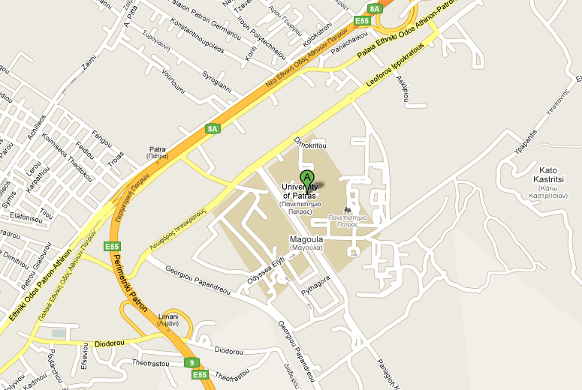
Planar Graphs
Notes:
A quick reminder about planar graphs.
So this is where we are.
On the right you can see that no road goes over no other road.
Hence we call this part of the map planar.
However, the left side is not planar. You can see that there are atleast two underpasses in this side of the graph.

Slide 10







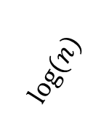




Recursive Graph Decomposition
$$T$$
$$G$$
$$log⁡(n)$$
$$G_{01}$$
$$G_{0}$$
$$G_{1}$$
$$G_{00}$$
$$G_{00}$$
$$G_{01}$$
$$G_{0}$$
$$G$$
$$G_{1}$$
Notes:
For a rooted spanning tree in a graph and non-tree edge, we call the cycle formed by branches of the endpoints of the non-tree edge the “fundamental cycle”.
In the case of planar graphs, it is possible to find a fundamental cycle which separates the graph into two almost-equal sized graphs.
Because of this property, we can recursively separate a planar graph up to logn times.
This is why the planarity of the graph is required.

Slide 11
Previous Results
Standard (vertex-vertex) oracles for planar graphs:
Many results. Most (including ours) build on:
Thorup. Compact oracles for reachability and approximate distances in planar digraphs. [STOC 2001, J. ACM 2004]
Vertex–Label oracles:
Introduced by Hermlin, Levy, Weimann, Yuster ‘11
For planar graphs :
Li, Ma, Ning [TAMC ’13]
Łącki, Oćwieja, Pilipczuk, Sankowski, Zych [STOC ’15]
Abraham, Chechik, Krauthgamer, Wieder [APPROX ’15]
Notes:
So standard oracles are discussed about more then a decade back.
However the question of vertex-label was introduced on 5 years back, and been addressed several times in different aspects.

Slide 12
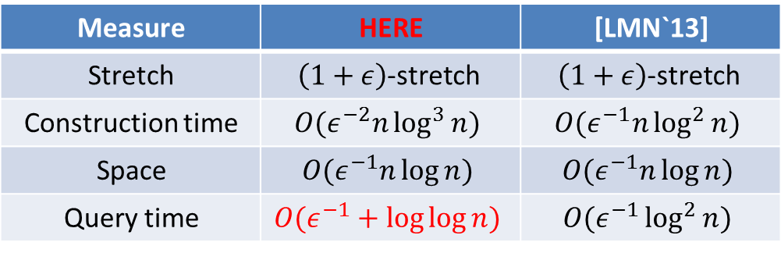
Our Result
Approximate Vertex label distance oracles for planar graphs
Similar result for directed planar graphs
Measure | HERE | [LMN`13]
Stretch | $\left(1+ε\right)$-stretch | $\left(1+ε\right)$-stretch
Construction time | $$O(ε^{−2}n\log^{3}{n})$$ | $$O(ε^{−1}n\log^{2}{n})$$
Space | $$O(ε^{−1}n\log{n})$$ | $$O(ε^{−1}n\log{n})$$
Query time | $$O(ε^{−1}+\log{\log{n}})$$ | $$O(ε^{−1}\log^{2}{n})$$
Notes:
The rest of the talk will discuss our result for undirected planar graphs.
You can see the comparison to the latest state of the art oracle.
You can see that both have near linear construction time and space, however our oracle’s query time is nearly constant.

Slide 13
Why is it difficult to convert an oracle?
Notes:
We will talk now on how to address the vertex-label problem, given we know how to address the standard problem of vertex-to-vertex distance.

Slide 14
Vertex-Label Approach
What we would have liked to do:
0
0
0
Planarity
0
0
Teleportation
0
0
0
Why shouldn’t we ?
Notes:
Well, given a labeled graph, for each label we could add an apex which represents the label in the graph.
First you can see that it doesn’t matter where we draw the blue-apex, the graph will turn to be non-planar.
Second, you can see that we have introduced new zero length paths to the graph.
You can see in the shown that we have actually “teleported” from one blue vertex to another.
Add zeros.

Slide 15


Vertex-Label Approach
What we’d really like to do:
Planarity
Teleportation
Notes:
To deal with the teleportation, we offer the following approach :
Add apices one after the other and compute the correct distances from a vertex to a label.
Note that the zero length path added each time are only of a single label which we compute distances to, and therefore we should worry about it.
However, had we done so, we actually multiplied the construction time by the number of label, which we should avoid.
This is because, as I mentioned earlier, the number of labels might be of order n.

Slide 16
Our approach
Use thorup’s oracle
Morally: add all apices simultaneously
Practically: don’t add apices at all,
Show how to compute the data for each apex from the existing vertices of that label.
Notes:
So what we actually do, we compute the data for each labeled-apex using the data of the labeled vertices without actually adding these apices to the graph.
Since we compute this data efficiently, the construction time remains the same.

Slide 17

Taste #1
Notes:
We now dive into more technical parts of the result, and we will first talk about eps-covers.

Slide 18








Thorup’s $ε$-covers
a $ε$-covers q w.r.t. vertex v if
$$δ\text{(}\text{v}\text{,}\text{a}\text{)+}δ\text{(}\text{a}\text{,}\text{q}\text{)}$$
$$≤ \text{(}\text{1}\text{+}ε\text{)}$$
$$δ\text{(}\text{q}\text{,}\text{v}\text{)}$$
$$δ\text{(}\text{u}\text{,}\text{b}\text{)+}δ\text{(}\text{b}\text{,}\text{q}\text{)}$$
$$≤ \text{(}\text{1}\text{+}ε\text{)}$$
$$δ\text{(}\text{q}\text{,}\text{u}\text{)}$$
a
u
q
v
b
Q
Can approximate distance between u and v using a and b
Notes:
Well, we say vertex a eps-covers vertex q if the distance from v to q well approximated by the path from v to q which goes through vertex a.
This definition is useful since if we had knew that vertex b covers vertex q with respect to vertex u, the distance of the path from v to u through q is approximated by the v to a to b to u distance.

Slide 19
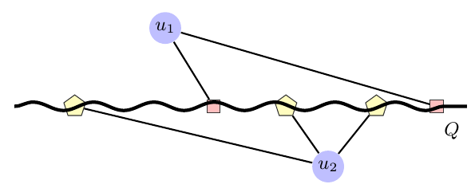
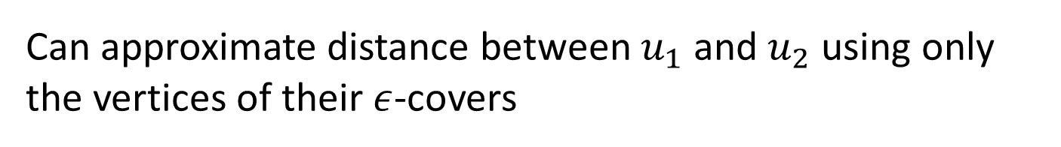


Thorup’s $ε$-covers
$C\left(v,Q \right)⊂Q$ is an $ε$-covering set of Q w.r.t. $v$
if every q in Q has some a $∈C(v,Q)$ s.t. a $ε$-covers q.
Can approximate distance between $u_{1}$ and $u_{2}$ using only the vertices of their $ε$-covers
Notes:
More over, we would like to look at covers sets.
The set of red vertices form the cover of u_1 on Q.
You can see that each vertex has different cover set, which cover all vertices along Q.
Using these set, and assuming Q separates u1 from u2, the shortest path distance that intersects Q and goes from u1 to u2 can be approximated.

Slide 20
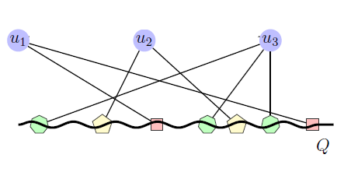


Thorup’s $ε$-covers
$$Thorup 2004:$$
$$Let Q be a shortest path.$$
$Computing O\left(ε^{−1}\right) sized sets \left\{C\left(v,Q\right)\right\} for all vertices in G$
$$can be done in near linear time.$$
First, compute cover of size $O(ε^{−1}\log{n})$ for each.
Second, thin it to $O(ε^{−1})$ sized cover set.
Notes:
Thorup showed it is possible to compute these covers simultaneously for several vertices.
He first finds a big sized cover and then thins it into a cover of almost constant size.

Slide 21
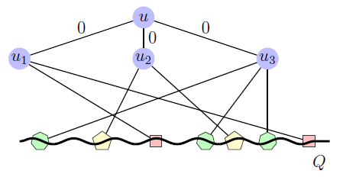


$ε$-covers for labels
We extend Thorup’s thinning procedure.
Lemma: One can compute a $3ε$-cover for label $λ$;
using all $ε$-covering sets of all $λ$-labeled vertices in a graph,
in linear time in the size of the covers.
Notes:
We take the idea of thorup and show how to thin the covers of several vertices into a single cover.
This way we can compute a cover for an apex.
Since for each label we consider only the covers of the vertices label with it, we spend linear time with respect to the graph.

Slide 22
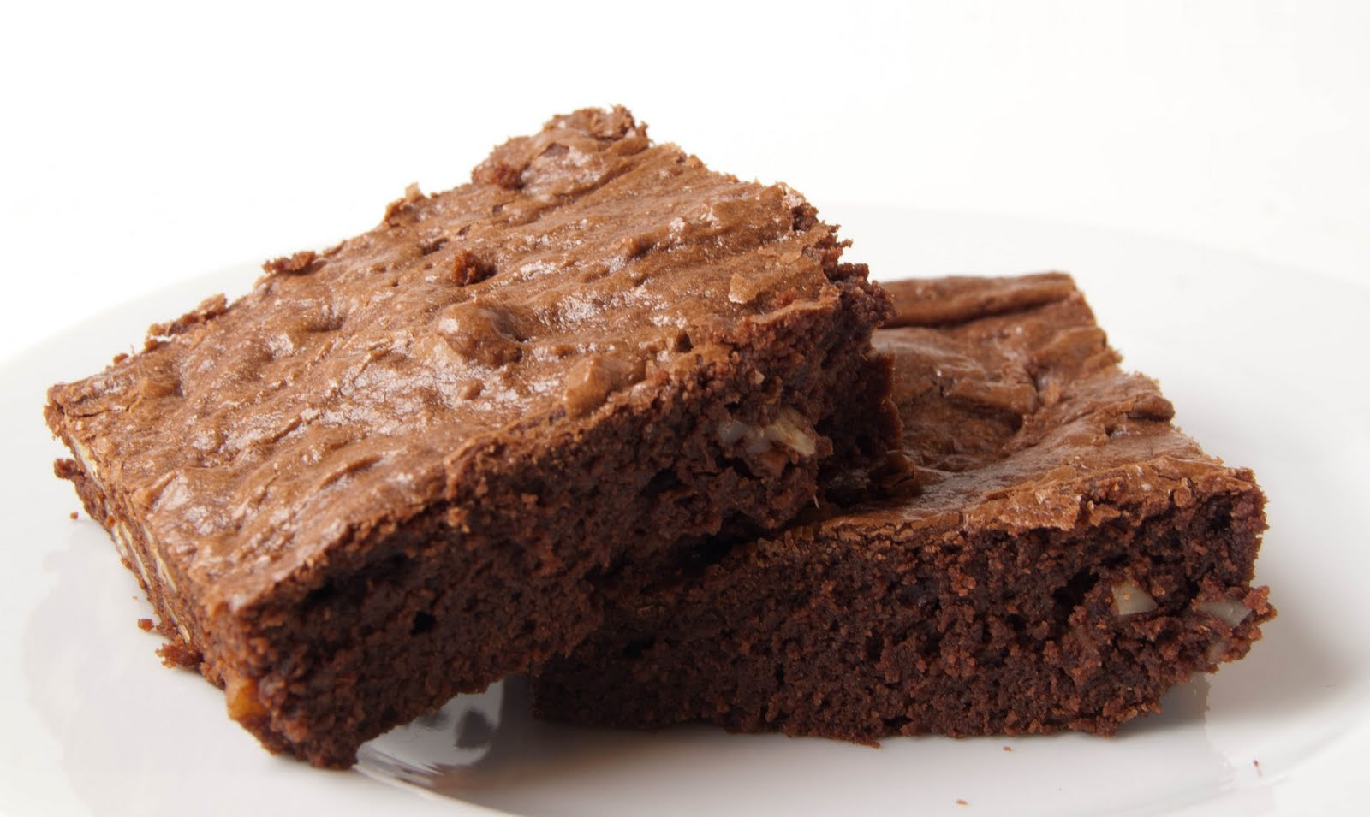
Taste #2
Notes:
Moving on now to a second technical point.

Slide 23











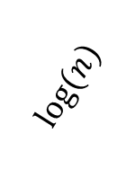
Recursive Graph Decomposition
$$T$$
$$G$$
$$log⁡(n)$$
$$G_{01}$$
$$G_{0}$$
$$G_{1}$$
$$G_{00}$$
$$G_{00}$$
$$G_{01}$$
$$G_{0}$$
$$G$$
$$G_{1}$$
Notes:
We have talk about the recursive separation that can be enabled over planar graphs.
In the previous taste, we have talked about covers which kept the distance to a graph.
We also said that given a specific path it is possible to estimate the distance of a path between 2 vertices that intersect it.
The paths used are actually the paths of the fundamental cycles we have mentioned right here.
Each fundamental cycle is composed of two paths which are the branches of the spanning tree.

Slide 24




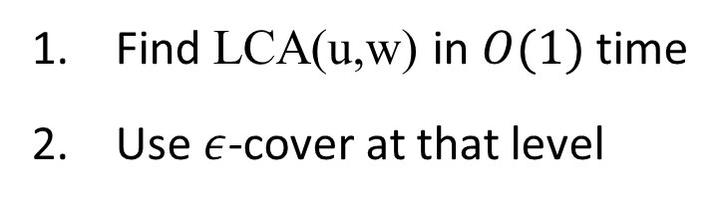








Choosing appropriate $ε$-covers for a query
In Thorup’s Oracle
(vertex-vertex)
$$w$$
$$u$$
$$G$$
Find LCA(u,w) in $O(1)$ time
Use $ε$-cover at that level
$$G_{0}$$
$$G_{1}$$
$$G_{00}$$
$$G_{01}$$
$$w$$
$$G_{000}$$
$$G_{001}$$
$$u$$
Notes:
So, if this is the recursive decomposition,
we could have queried the paths of the separator of the LCA subgraph for the distance between u and w.
The distances, unlike one as for now thinks, are actually in the whole graph, and only in the subgraph calculated.
This property is needed since a shortest path might intersect a lot of separators which were not present in the subgraph of the LCA.

Slide 25












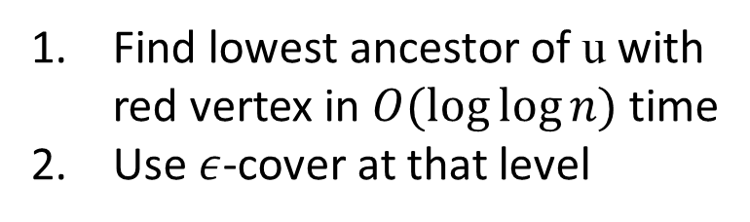



Choosing appropriate $ε$-covers for a query
In Our Oracle
(vertex-label)
$$w_{2}$$
$$w_{1}$$
$$u$$
$$w_{3}$$
$$G$$
Find lowest ancestor of u with red vertex in $O(log⁡log⁡n)$time
Use $ε$-cover at that level
$$G_{0}$$
$$G_{1}$$
$$w_{3}$$
$$G_{00}$$
$$G_{01}$$
$$w_{1},w_{2}$$
$$G_{000}$$
$$G_{001}$$
$$u$$
Notes:
Now lets assume there are several red-label vertices in different subgraphs of the decomposition.
We need to find which separator to query.
The correct subgraph to query is the minimal LCA separator between u and a red-vertex.
This is because any path from u to a red-vertex most intersect this separator.

Slide 26
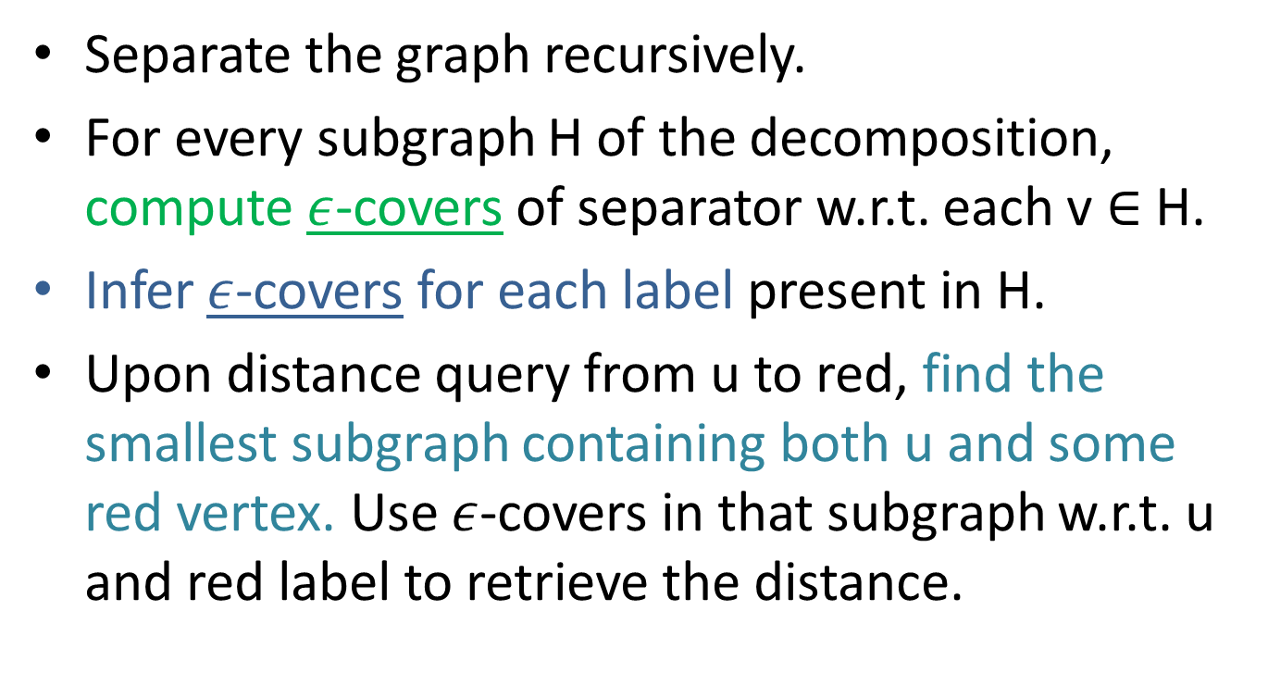
Summary
Separate the graph recursively.
For every subgraph H of the decomposition, compute $ε$-covers of separator w.r.t. each v ∈ H.
Infer $ε$-covers for each label present in H.
Upon distance query from u to red, find the smallest subgraph containing both u and some red vertex. Use $ε$-covers in that subgraph w.r.t. u and red label to retrieve the distance.

Slide 27
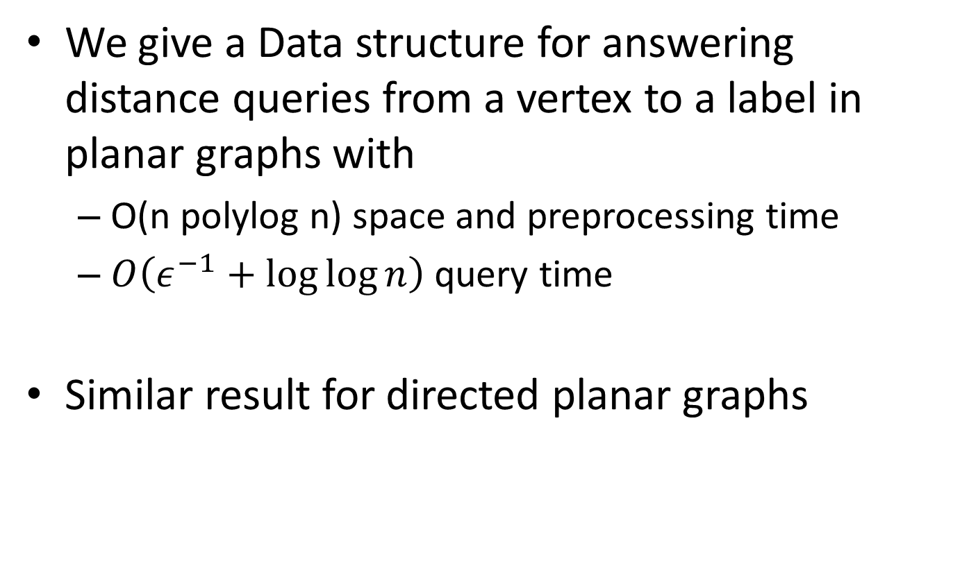
Conclusion
We give a Data structure for answering distance queries from a vertex to a label in planar graphs with
  O(n polylog n) space and preprocessing time
  $O\left(ε^{−1}+\log{\log{n}}\right)$ query time
Similar result for directed planar graphs

Slide 28
Questions ?
Notes:
Lastly, mention a directed result is achieved by reducing the directed problem to a similar problem
in which Thorup’s eps-cover construction is applicable.

